Slide 1

Impact of Hypersonic Weapons on National Security and Crisis Instability

Slide 2
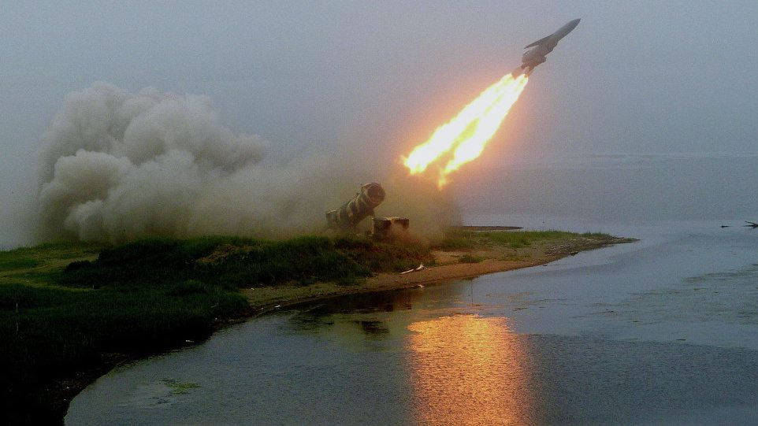
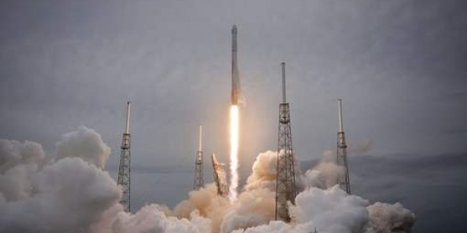
"Both Russia and China are aggressively pursuing hypersonic capabilities...We’ve watched them test those capabilities. We don't have any defense that could deny the employment of such a weapon against us.”
-General John E Hyten, Commander of U.S. Strategic Command (2o18)

Slide 3
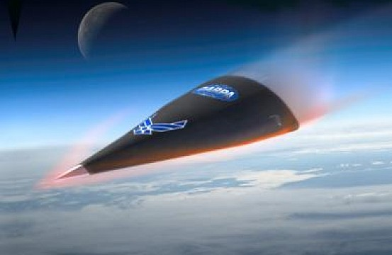
Characteristics of Hypersonic Weapons
Speed: Travel at speeds above Mach 5 (above 5x the speed of sound.) Maintain this speed unlike existing missiles.
Maneuverability: Path and/or target may be altered mid-flight.
Altitudes: Fly at lower altitudes than ballistic missiles.
Hypersonic Glide Vehicle

Slide 4
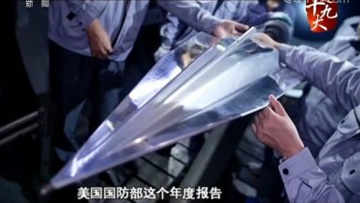
Global Hypersonic Weapons Testing and Research
China DF-17 (HGV)
2 successful tests in November 2017, could be operational by 2020.
Russia
Kh 7-M2 Kinzhal (Mach 10) 2018

Slide 5
Hypersonic Weapons Will:
Nullify existing missile defense systems.
2. Destabilize military balances on large and local scales.
Deterrence strategy will ultimately be disrupted.

Slide 6
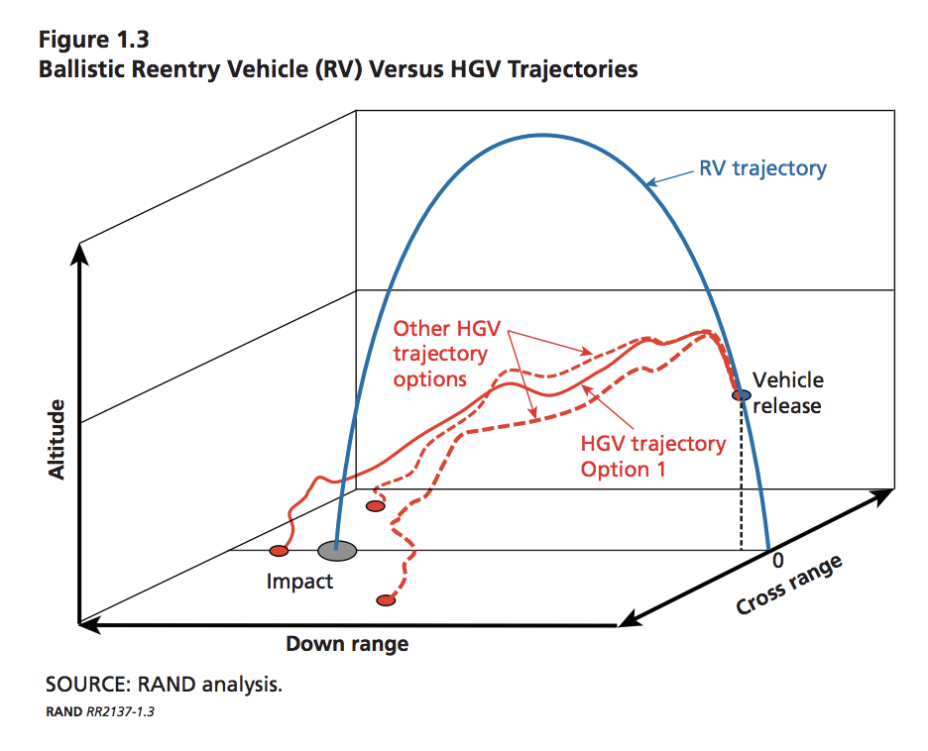
1A. Nullify Existing Missile Defense Systems: Trajectory
Red: Possible flight paths for hypersonic glide vehicles.
Blue: Flight path of typical re-entry vehicles (e.g. ICBMs)

Slide 7
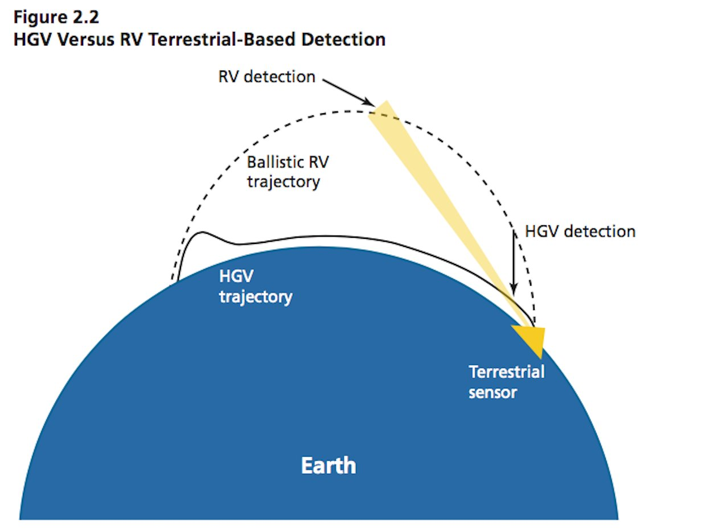
1B. Nullify Existing Missile Defense Systems: Altitude
---- Re-entry Vehicle
___ Hypersonic Glide Vehicle

Slide 8
2A. Destabilize Military Balances on Large and Local Scales: Crisis Instability
"Crisis instability is the condition that exists when either leader feels pressure because of emotion, uncertainty, miscalculation, misperception, or the posture of forces to strike first to avoid the worse consequence of incurring a first strike.” (Linhard, 1995)

Slide 9
2B.Destabilize Military Balances on Large and Local Scales: Strategic Consequences
Compressed Reaction Times
Trigger Happy Postures
Threat to U.S. defenses/allies/aircraft carriers abroad.

Slide 10
Recommendation 1: Reach an Agreement With Russia and China that Encourages Nonproliferation Practices
Limit export of hypersonic vehicles and major subsystems.
Indigenous development is extremely expensive and difficult.
Nonproliferation treaties have worked in the past. (NPT, 191 countries signed, only 1, North Korea, withdrew.)

Slide 11
Recommendation 2: The U.S. Government Should Prioritize Development and Continued Support of Space-Based Missile Detection Alongside Ground-Based Defense
Lt. General Samuel Greaves: Satellite sensors are at Technology Level Readiness 6.
A comprehensive approach could use satellite sensors in order to make ground-based defense more effective.
Layer of satellites for “birth to death” detection of missiles.
Satellite sensors could improve “boost phase” detection--->effective against a HGV launch.
Missile Defense Agency should lead development in collaboration with United States Air Force.

Slide 12
Works Cited
Acton, James M. “Hypersonic Weapons Explainer.” Carnegie Endowment for International Peace, carnegieendowment.org/2018/04/02/hypersonic-weapons-explainer-pub-75957.
Fabey, Mike. “North Korea Puts Spotlight on U.S. Space-Based Missile Defense.” SpaceNews.com, 15 Aug. 2017, spacenews.com/north-korea-puts-spotlight-on-u-s-space-based-missile-defense/.
Hyten, John. STATEMENT OF JOHN E. HYTEN COMMANDER UNITED STATES STRATEGIC COMMAND BEFORE THE HOUSE ARMED SERVICES STRATEGIC FORCES SUBCOMMITTEE 7 MARCH 2018. www.stratcom.mil/Portals/8/Documents/2018%20USSTRATCOM%20HASC-SF%20Posture%20Statement.pdf?ver=2018-03-07-125520-187.
Linhard, Robert E. “Crisis Stability in a Multi-Polar World.” SpringerLink, Springer, Dordrecht, 1 Jan. 1995, link.springer.com/chapter/10.1007/978-94-015-8396-1_6.
“Missile-Tracking Satellites Are Part of the Plan to Foil Russia's Hypersonic Weapons.” SpaceNews.com, 20 May 2018, spacenews.com/missile-tracking-satellites-are-part-of-the-plan-to-foil-russias-hypersonic-weapons/.
Speier, et al. “U.S.-Russia-China Cooperation Could Hinder the Proliferation of Hypersonic Missiles.” RAND Corporation, 27 Sept. 2017, www.rand.org/pubs/research_reports/RR2137.html.
“The Nuclear Non-Proliferation Treaty.” The New Southbound Policy | Center for Strategic and International Studies, www.csis.org/analysis/nuclear-non-proliferation-treaty.
Weitz, Richard. “Arms Racing in Strategic Technologies: Asia's New Frontier - by Richard Weitz.” Policy Centers - Center for Global Prosperity - Hudson Institute, www.hudson.org/research/11307-arms-racing-in-strategic-technologies-asia-s-new-frontier.

Slide 13
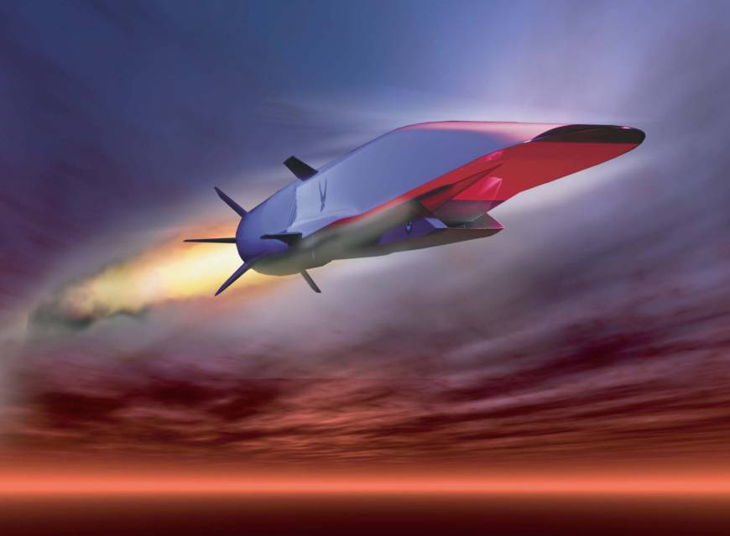
Hypersonic Weapons: Types
Hypersonic Glide Vehicle (HGV): Glides atop the atmosphere. Launched on ballistic missile and released at the appropriate altitude.
Hypersonic Cruise Missile (HCM): Low flying missile that is guided to its target. (Remains in the atmosphere). Similar function to subsonic cruise.

