Slide 1

Do the Crime, your Data is Mine
Naomi Rinaldo
August 8th, 2018

Slide 2
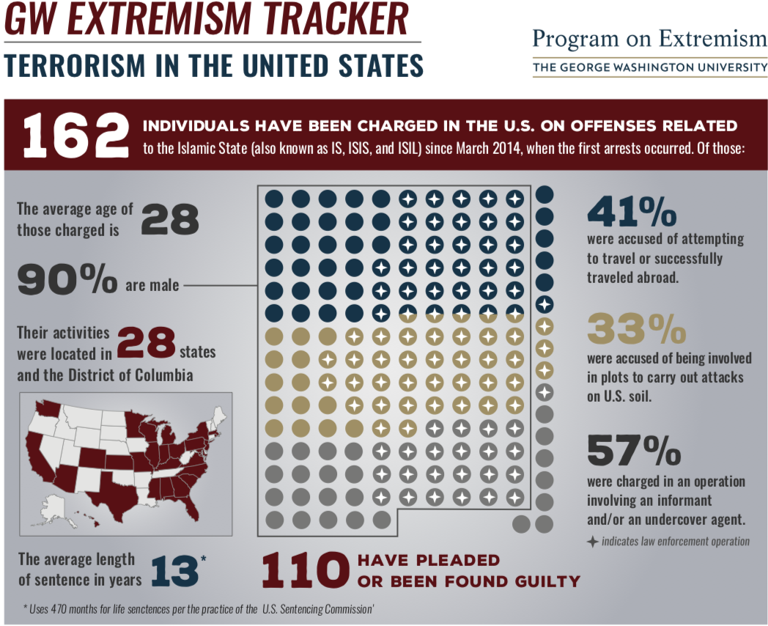
Growing Threat
June 2015-
250 individuals from the U.S. had traveled or attempted to travel to Syria or Iraq.
Currently-
The FBI is investigating homegrown violent extremists in every state.

Slide 3


Objectives
Stop the spread of violent extremism within United States prison systems.
Better understand the mechanisms of radicalization and potentially to be able to identify those who could be more susceptible to violent ideologies.

Slide 4

Counter Violent Extremism Strategies
Challenges:
Lack of funding.
Lack of lead agency.
Singular ideologic focus.
Resistance from Muslim communities.
Boston-
Interventions for radicalized individuals.
Minneapolis-St. Paul-
Societal level concerns.
Los Angeles-
Community engagement.
Notes:
However, one of the roots of the problem is a lack of relevant disengagement programs within the U.S. prison system, giving inmates who were initially arrested for terrorism little incentive or opportunity to reject their former ideology, and thus creating the possibility that they may continue to be involved in extremism post-release.

Slide 5
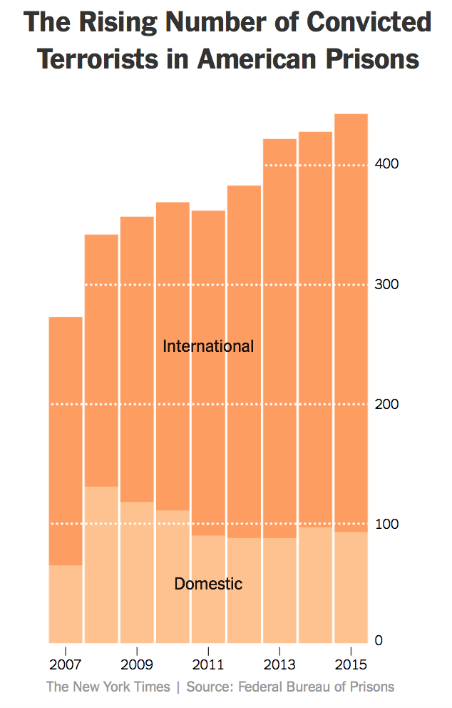
Prisoner Radicalization
U.S. prisons hold 443 convicted terrorists. (2016)
General population prisoners are easy targets to extremist ideology due to isolation from society and the search for something to belong to.
Although it is not always the case that terrorist plans are being created in prisons, there is a risk that newly radicalized inmates will be released and then carry out an act of violence.
Notes:
Prisons can be referred to as a breeding ground for violent ideologies.
“Such humble beginnings can provide a potent platform for Islamists to exert increasing influence over other prisoners.”

Slide 6
Kevin Lamar James
Indicted in 2005 for plotting to attack U.S. military facilities, Israeli government facilities, and Jewish synagogues in L.A.
Formulated this attack while in a California prison
Became radicalized while serving a ten year sentence for robbery.
Notes:
It should also be noted that those involved in high profile terrorist attacks in Barcelona, Brussels, London, Nice, and Jakarta, were initially imprisoned for non-terrorist offenses and are believed to have been radicalized to violence while in jail.

Slide 7
Policy Recommendation 1
Objective 1: Reduce spread of extremist ideology in prison systems
Enact segregation between general population prisoners and prisoners convicted due to acts of terror or extremism.
  Limits the spread of violent ideology
Establish a mandatory deradicalization program for extremist prisoners.
  Offers change in behavior and thought. Goal outcome is to prevent violent acts from being committed post-release.

Slide 8

“We just don’t know, because we aren’t tracking this category of prisoner, authorities are reluctant to target individuals based on their religion.”
-Eric Rosand, Former State Department Official
By tracking these prisoners via big data we can reduce the radicalization of prisoners and potentially find a correlation between extremists outside of religion.
Notes:
Eric Rosand, a former State Department official who runs the Prevention Project, a group that promotes community efforts to counter extremism, said it is difficult to assess the extent of radicalization in U.S. prisons.

Slide 9
Big Data
Collection of large amounts of data.
Automated analysis of mass amount of data.
The uncovering of hidden patterns and correlations.
New Insights and behavioral predictions.
Ex.) It’s a Wednesday + It’s partly cloudy + Naomi hit snooze on her alarm + She missed her train + She has to give a presentation today + She’s nervous + She’s wearing heels =
Her dinner will be a large slice of chocolate cake.

Slide 10

Your Data is Mine
Once convicted of an act of terror or flagged as being radicalized in prison you render your information for big data predictive analysis.
Neurological Data + Genetic Information + Hormones + Psychological Profile + Digital and Online Activity + Behavior + Cultural Background =
Potential identifier for someone who could be radicalized.

Slide 11
Policy Recommendation 2
Objective 2: Utilizing big data
Require those imprisoned due to acts of terror or that have been flagged as radicalized to give up certain information for big data analysis.
Use big data analytics to identify individuals who could potentially be more susceptible to radicalization.
  Keep a behavioral profile and take early intervention action.

Slide 12

Could this have been prevented?
Killed 49 and injured 53.
Identified himself as an “Islamic Soldier” and pledged himself to ISIS.
Was investigated for connections to terrorism by the FBI in 2013 and 2014. But was removed from the “Terrorist Watch List.”

Slide 13
Policy Recommendation 3
Objective 2: Utilizing big data
Task an organization with running big data analytics and store information gathered.
  FBI
Can compare results to flagged individuals and conduct enhanced investigations.

Slide 14
Sources
Gartenstein-Ross, D. (2016, September 14). Radicalization in the U.S. and the Rise of Terrorism. Washington, DC: House Committee on Oversight and Government Reform, Foundation for Defense of Democracies. Retrieved from https://oversight.house.gov/wp-content/uploads/2016/09/Gartenstein-Ross-Statement-Radicalization-9-14.pdf
The Rise of Radicalization: Is the U.S. Government Failing to Counter International and Domestic Terrorism?: Before the U.S. House of Representatives Committee on Homeland Security. July 15, 2015. (Testimony of Seamus Hughes)
Combating Homegrown Terrorism: Before the U.S. House of Representatives Oversight and Government Reform. July 27, 2017. (Testimony of Seamus Hughes)
Brandon, J. (2009). The Danger of Prison Radicalization in the West . Combating Terrorism Center Sentinel , 1-4.
Wilson, S. (2017, October 5). Terrorism in Foreign Prisons: Countering Recruitment and Rehabilitating Offenders. Retrieved from DIPNOTE U.S. Department of State Official Blog: https://blogs.state.gov/stories/2017/10/05/en/terrorism-foreign-prisons-countering-recruitment-and-rehabilitating-offenders
Hannah Fairfield, T. W. (2016, April 7). The Terrorists in U.S. Prisons . Retrieved from New York Times: https://www.nytimes.com/interactive/2016/04/07/us/terrorists-in-us-prisons.html
Hamm, M. S. (2008, October 27). Prisoner Radicalization: Assessing the Threat in U.S. Correctional Institutions. Retrieved from National Institute of Justice : https://www.nij.gov/journals/261/pages/prisoner-radicalization.aspx
Donati, J. (2018, Februrary 6). U.S. Prisons Allow Extremism to Fester, Study Warns. Retrieved from The Wall Street Journal: https://www.wsj.com/articles/u-s-prisons-allow-extremism-to-fester-study-warns-1517930107
(2018, July 20). Retrieved from Federal Bureau of Prisons : https://www.bop.gov/about/history/timeline.jsp
Marr, B. (2017, March 14). The Complete Beginner's Guide to Big Data. Retrieved from Forbes: https://www.forbes.com/sites/bernardmarr/2017/03/14/the-complete-beginners-guide-to-big-data-in-2017/#3f34927e7365

Slide 15
Thank You!
Questions?

