Slide 1
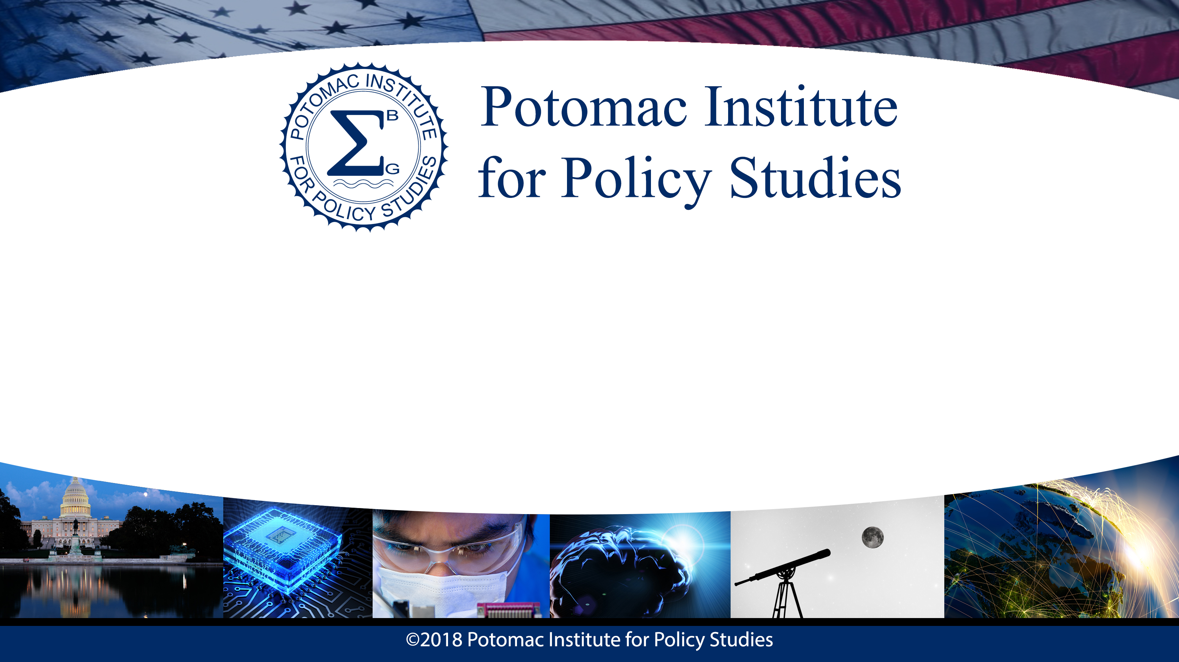
Synthetic Biology for Space Outposts
Zachary Eldredge
Intern, PIPS
8/8/2018

Slide 2
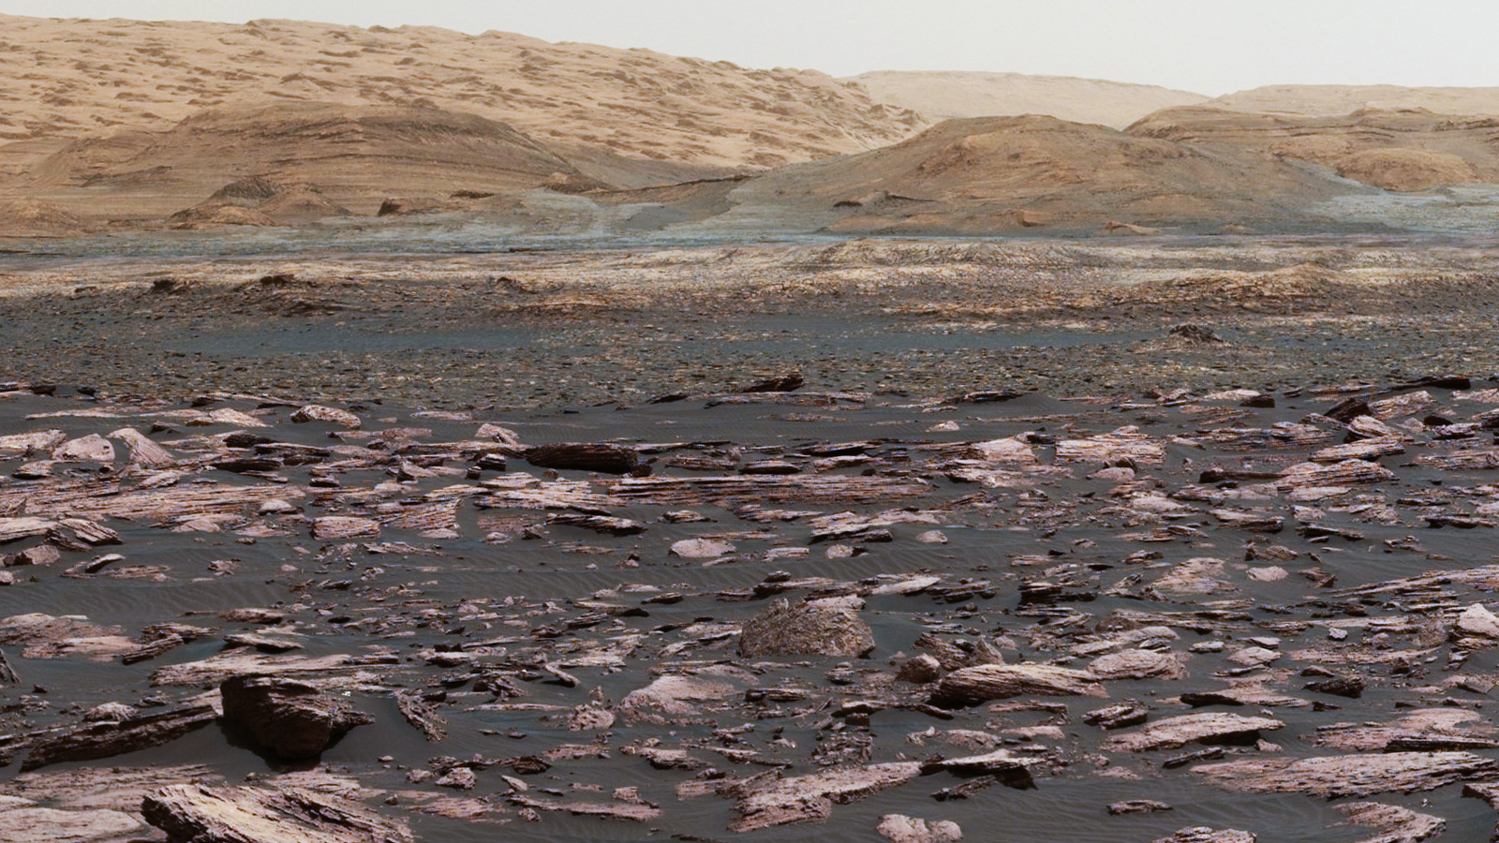
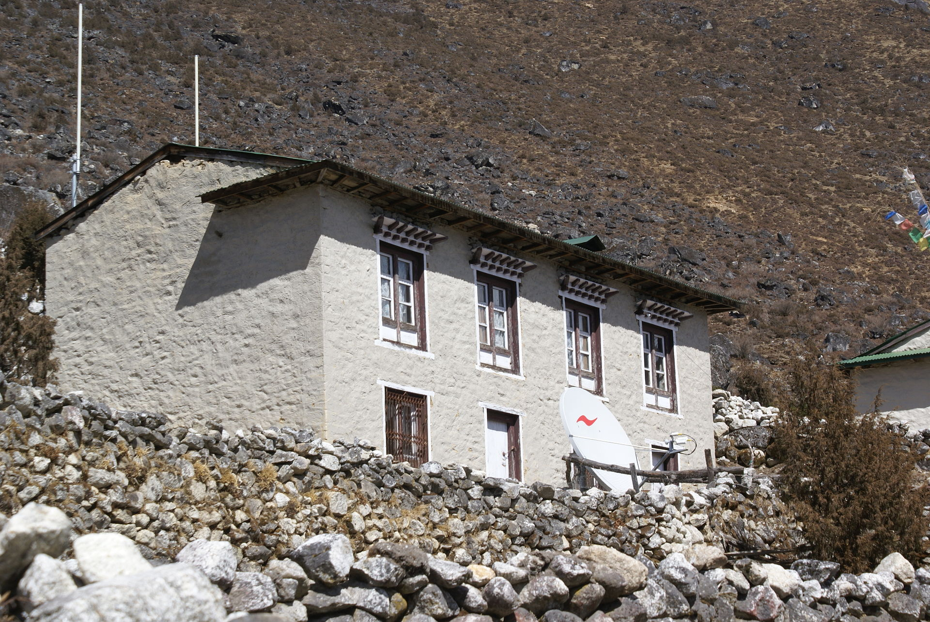
So You Want To Live On Mars
“the United States will lead the return of humans to the Moon for long-term exploration and utilization, followed by human missions to Mars and other destinations.”
Space Policy Directive 1, 12/11/2017

Slide 3
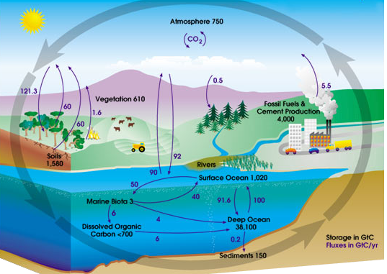
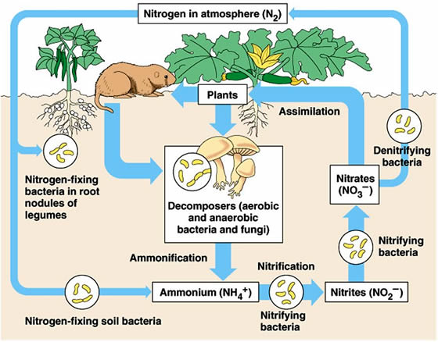
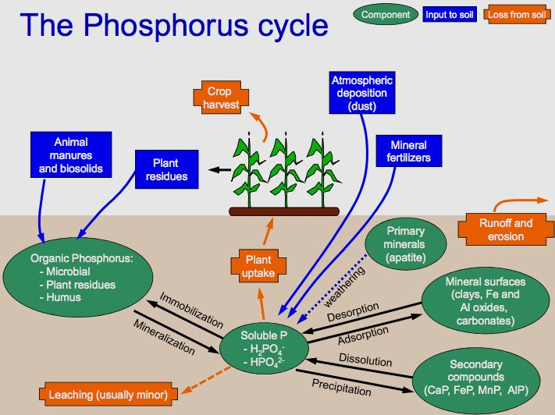
We Live In Biogeochemical Cycles
Carbon
Nitrogen
Phosphorus
Images from Wikimedia Commons

Slide 4
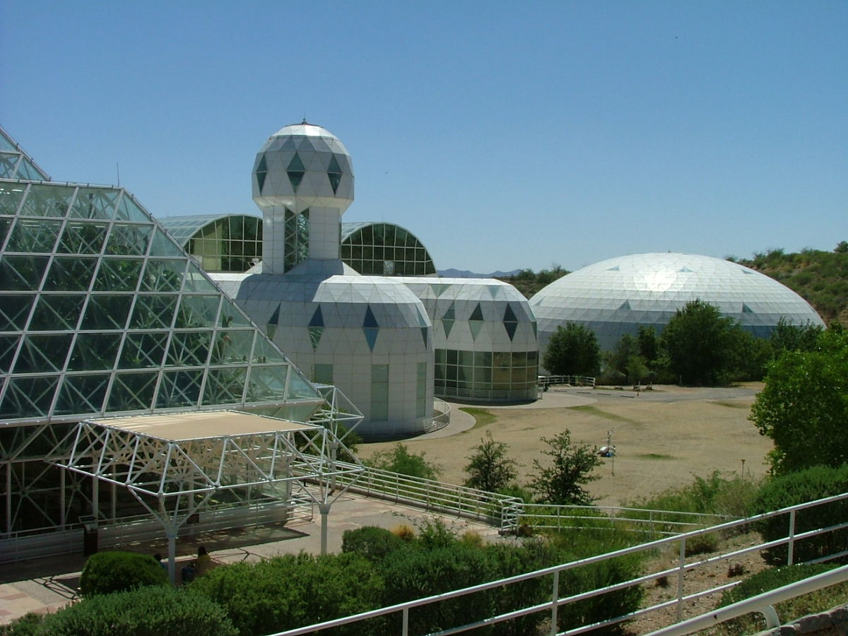
Building New Biogeochemical Cycles
Biosphere 2:
  Closed, 3 acre, ecological system
  A small team lived there for two years (1991-1993)
  Many atmospheric, agricultural, psychological problems

Slide 5
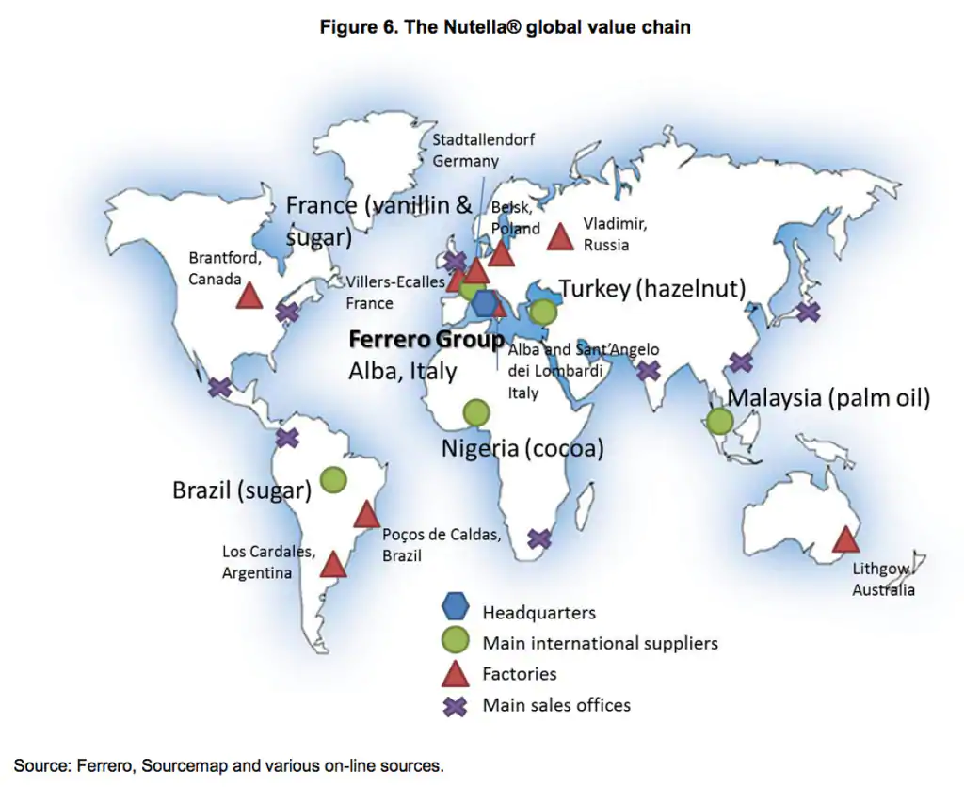
Another Global System: Industry
The Nutella Global Supply Chain
From Michigan State University

Slide 6
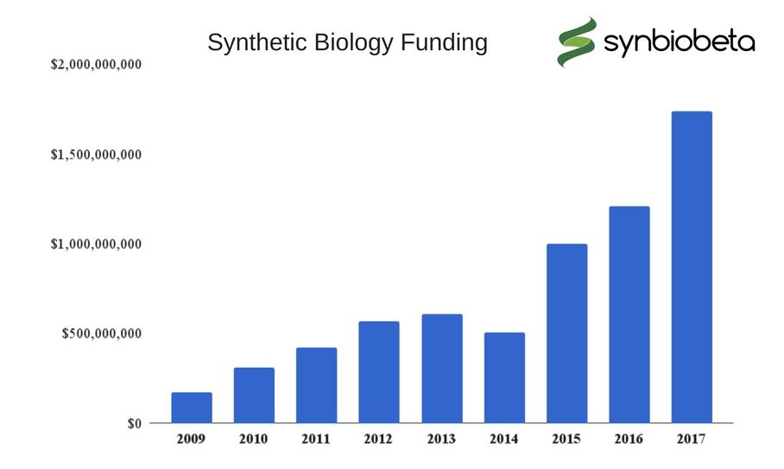
Synthetic Biology
Synthetic biology is the creation of new biological processes, capabilities, and even organisms that do not exist in nature.
Existing applications of SynBio include:
  Production of artemisin (anti-malarial drug)
  Production of biofuels (esp. from cellulose)
  Biosensing (detecting radiation or harmful chemicals)
SynBio Startup Funding

Slide 7
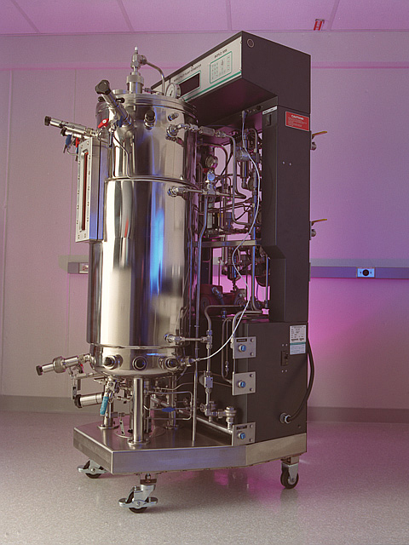
SynBio For Space: Right Style
SynBio is…
  Versatile: one framework for many solutions
  Low mass biological “parts”
  Sustainable: Earth SynBio is focused on environmental feasibility and waste recycling
A closed bioreactor used in cellulosic ethanol research. Department of Energy. Image from Wikimedia.

Slide 8
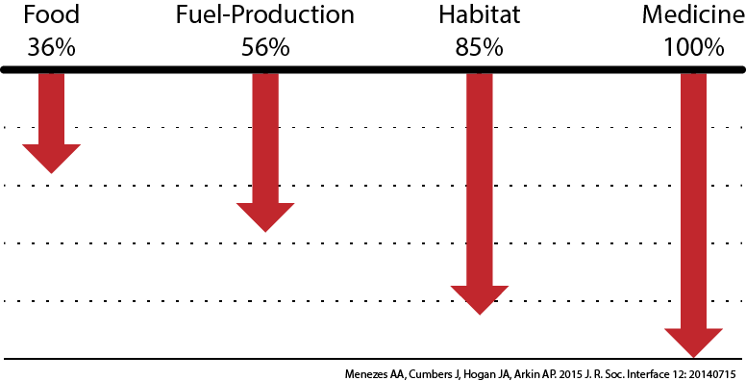
SynBio For Space: Right Applications
Mass Reductions from SynBio on Mars Mission
Launching one unit of payload means launching 99 units of other mass (fuel, etc.) so we should keep mass to a minimum!
Another potential application: microbial management
  Medical uses (insulin production is a current example)
  Ecological uses (soil microbes)

Slide 9
Three Recommendations
What we need to do to make SynBio in space a reality.

Slide 10
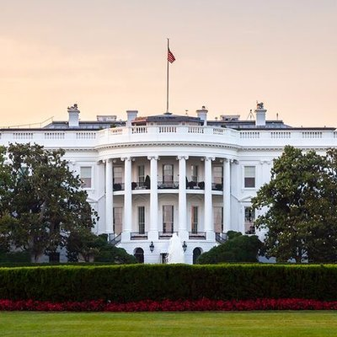
Federal Coordination, More NASA
Recommendation 1: Create a federal coordinating body that includes NASA and funds synthetic biospheres research.
No federal coordinating body for synthetic biology, although $140m/year in funding
<1% of SynBio funding is NASA
No overarching strategy or roadmap, tech not space-oriented

Slide 11
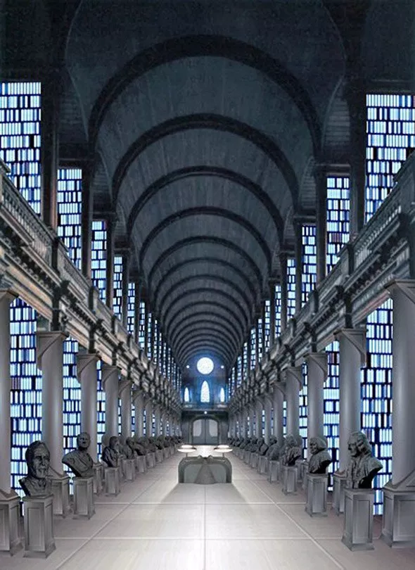
Standards and Intellectual Property
Recommendation 2: Create and enforce standards and keep the IP landscape clear.
  Use “open science” policies
  Use Bayh-Dole authority
Basic “parts” for SynBio might not work together, might be patent-locked
Stops SynBio from being universal platform

Slide 12
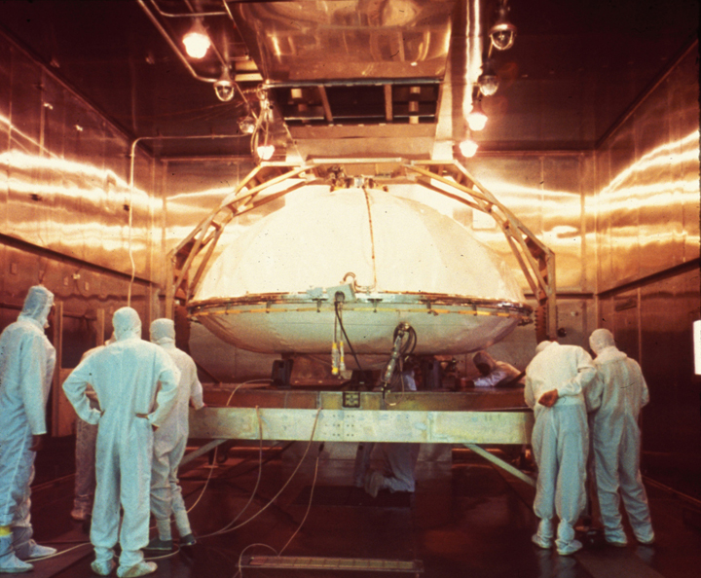
Planetary Protection
Recommendation 3: Fund synthetic biology research in planetary protection.
Lots of SynBio safety research through DARPA and others, but we also need to protect other planets
We need to think about containing or limiting artificial organisms in space environments

Slide 13
Conclusion
Synthetic biology is a big opportunity for creating new biospheres and economies in space and on Earth.
We need to focus more on developing the field, unified governance, and co-designing for space applications as terrestrial applications take off.

Slide 14

Questions?

Slide 15
Sources Used
Space Policy Directive 1: https://www.whitehouse.gov/presidential-actions/presidential-memorandum-reinvigorating-americas-human-space-exploration-program/
Biosphere 2: Severinghouse, Jeffrey P. et al, Eos, Vol. 75, No. 3, January 18, 1994.
SynBio mass reductions: Menezes AA, Montague MG, Cumbers J, Hogan JA, Arkin AP. 2015 “Grand challenges in space synthetic biology.” J. R. Soc. Interface 12
SynBio funding stats: The Wilson Center Synthetic Biology Project, “U.S. Trends in Synthetic Biology Research Funding.” September 2015.
Government patent use: Kapczynski, A. and Kesselheim, AS. “‘Government Patent Use’: A Legal Approach To Reducing Drug Spending.” Health Affairs 35 (5). May 2016.

