Slide 1

A Dangerous Duo: Advancing Technologies and Stagnant Mental Illness Levels
Emma Brehany
August 8, 2018
Notes:
Change title

Slide 2
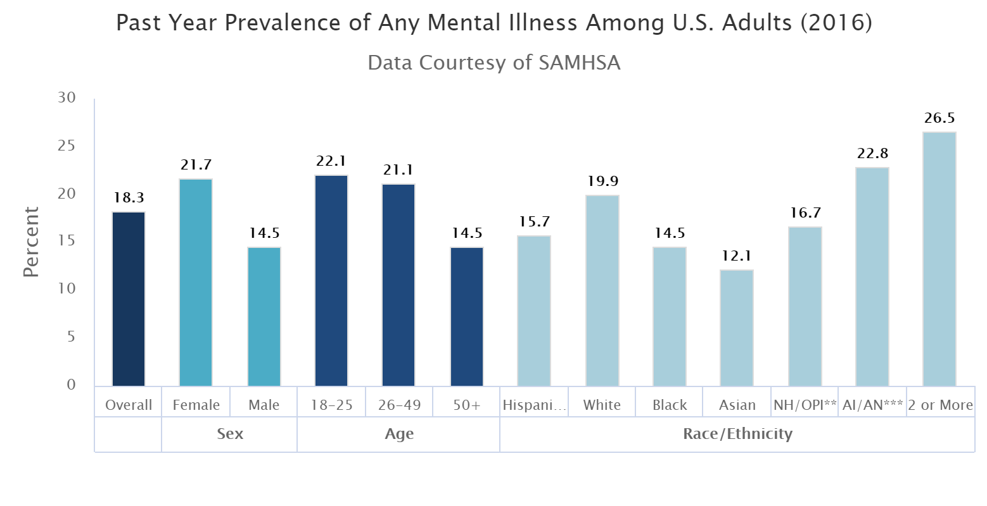
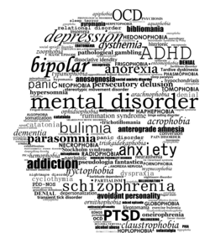
Mental Illness (MI):
Prevalence Remaining Idle
Genetics + Environment + Lifestyle
  Affects thinking, feeling, mood
One-year (20%) vs Lifetime Prevalence (~80%)
Toll has grown past 20 years (death/disability calculations)
  More access to treatment yet no improvement

Slide 3
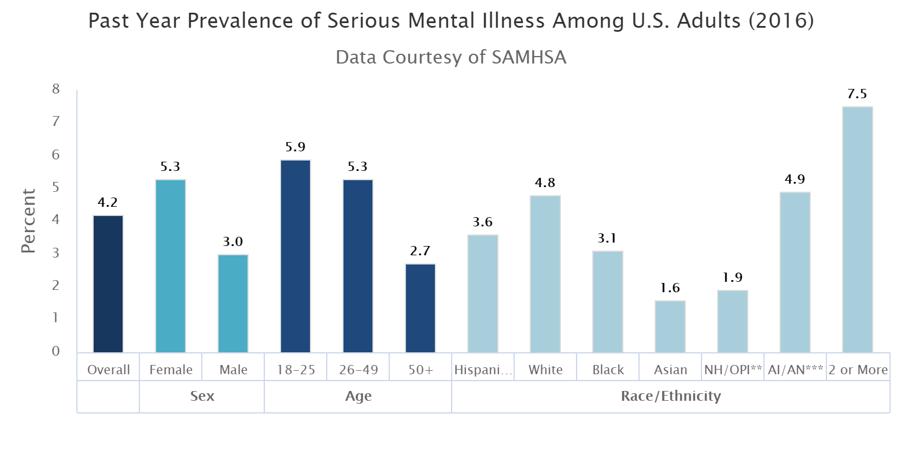
~300-500k Seriously Mentally Ill American Adults Are Violent
Violent SMI
Any Mental Illness (AMI) varies in impact
Serious Mental Illness (SMI)
  Greatly impaired in functioning/daily life tasks
  4.2% or 10.4 million U.S. adults (2016)
  3-5% violent (312-520k)
SMI
AMI

Slide 4
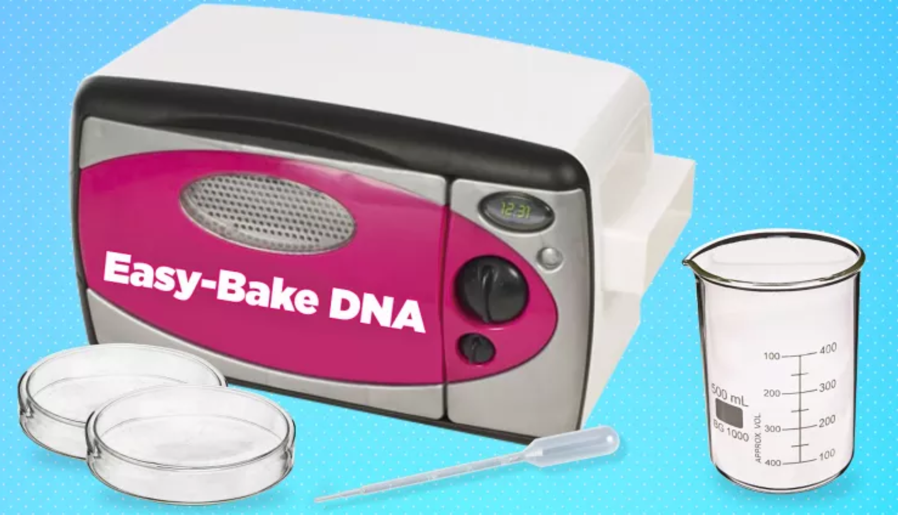
Advancing Tech: Cause for Concern
Technological advancements capable of mass destruction are becoming cheaper, more accessible and easier to use
Dual-Use Technology
  Normal scientific developments harnessed as weapons
  Pro: Medical + agricultural benefits
  Con: Lowering hurdles for weaponization
Blast Radius vs. Unbound

Slide 5
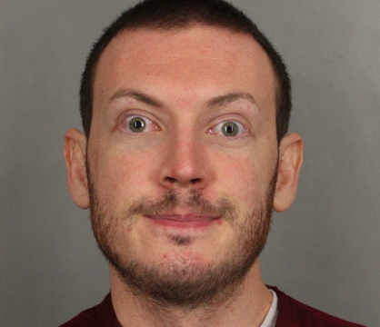

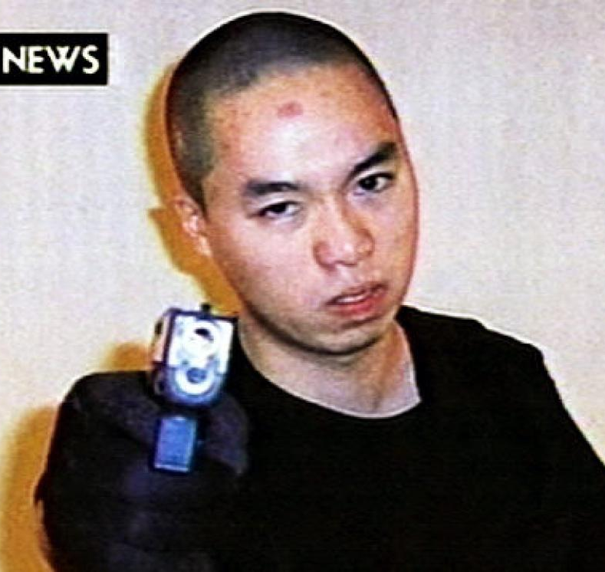

“20 doctors…all agree he suffers from schizophrenia”
“Someone is in my brain, telling me stuff to do”
New technologies capable of mass destruction becoming cheaper, more accessible and easier to use
+
Inefficient current “treatments” for mental illness
=
Serious threat to the United States
“Long list of disciplinary problems and mental health concerns”
“His symptoms of depression and anxiety had persisted”
Notes:
James Holmes – 2012 CO Movie Theater. 12 killed, 70 injured.
Nikolas Cruz – 2018 HS shooting in Parkland. 17 students/faculty killed.
Tamerlan Tsarnaev –2013 Boston Bombing. 3 killed, 264 injured.
Seung Hui Cho – 2007 VT shooting. 32 killed.
GAP CLOSING

Slide 6
Our Two Choices
Halt Technological Innovation
Work to Cure Mental Illness

Slide 7
Identified Problems Slowing Progress in MI Mitigation
Lack of Funding and Prioritization of MI
Poor MI R&D Tech Transition
Inadequate Current MI “Treatments”
Security Risks With Emerging MI Tech
Accessibility to Emerging MI Tech
Failure to Use Big Data for MI Detection/Threat Prevention

Slide 8
Recommendation 1: Prioritize MI Through Increased Funding and Basic Research
 | 2016 Prevalence | 2016 Budget | $/Case | % Budget
Cancer | 15.1 M | 5,589 M | $369.84 | 3.19 %
Mental Illness | 44.7 M | 826 M | $18.49 | 0.47 %
Prioritize understanding of mental illness shown through increased funding and basic research

Slide 9
Recommendation 2: Establish Permanent Technology Transition Office in DARPA
DARPA Programs – ElectRx & SUBNETS → non-pharma/plasticity
Short program manager terms, immature tech, lacking transition programs, missing data dissemination
Currently only has one temporary special project office (for aerospace)
Establish a permanent Technology Transition Office in DARPA that facilitates public-private partnerships to allow for technological transition from R&D

Slide 10
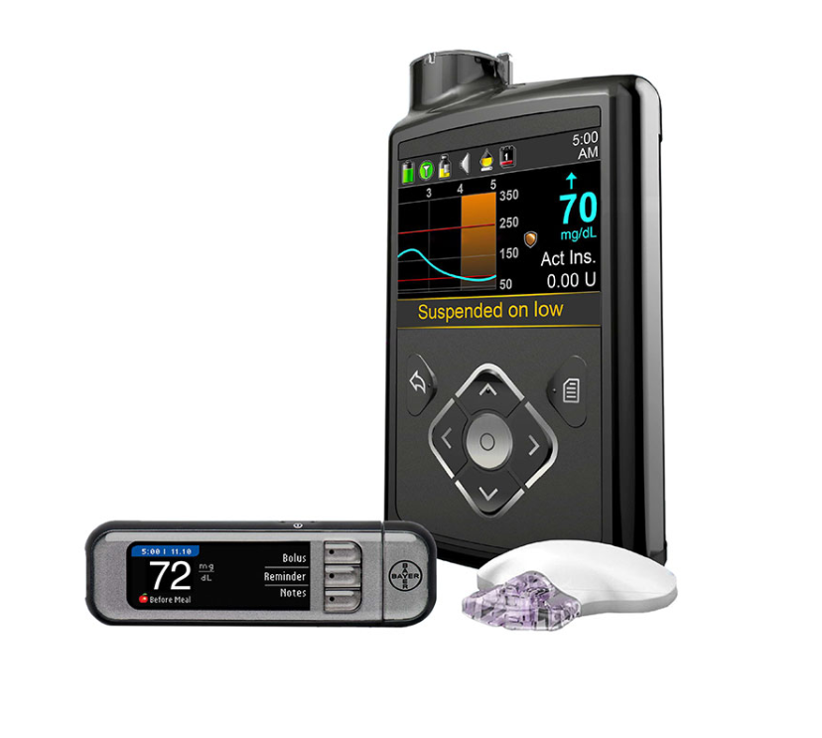
Recommendation 3: Create Automated, Internalized MI Treatments
Current Treatments = Symptom Management
Problems: self report bias, artificial environment, minimal data collection
Internalized Device
  Medtronic MiniMed670G for diabetics
  Dosage precision, responsibility removal
Develop new, automated, internalized technologies that revolutionize current MI treatments available through increased personalization and decreased responsibility

Slide 11

Recommendation 4: Require Cyber Experts Involvement in MI Tech Creation
Automated/internalized technologies pose security threat
Hacking the brain
  Data falsification? Turn off? Alter NT levels?
Cyber experts must be involved in the development of new tech (in addition to the engineers and physicians)

Slide 12
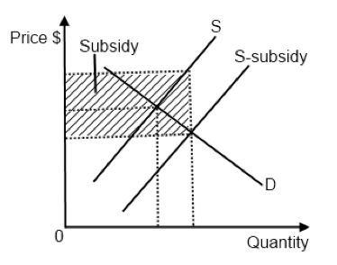
Recommendation 5: Subsidize Emerging MI Tech to Ensure Equal Access
Treatments lacking efficacy and availability
  44% of adults with MI received some form of treatment/service in past year (2014)
Provide government subsidy to ensure all needing emerging technologies receive it, not just those who can afford it/have insurance

Slide 13
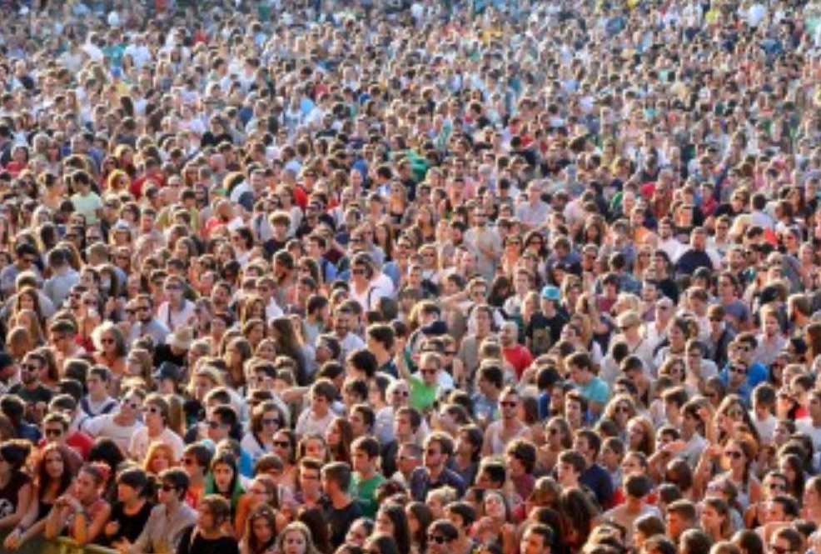
Recommendation 6: Develop Algorithms From Big Data to Predict Behavior & Prevent Attack
Street Cameras, Credit Cards, Social Media
Predicting Parkinson’s, Targeted Baby Ads, Psycholinguistics
Open-source big data to create algorithms from which AI can predict behavior and authorities intervene to prevent attack if necessary

Slide 14
References
SLIDE 2
https://www.nimh.nih.gov/health/statistics/mental-illness.shtml
https://www.nami.org/learn-more/mental-health-conditions
https://blogs.scientificamerican.com/observations/mental-illness-is-far-more-common-than-we-knew/
https://www.scientificamerican.com/article/is-mental-health-declining-in-the-u-s/
http://content.ebscohost.com/ContentServer.asp?T=P&P=AN&K=121071023&S=R&D=ehh&EbscoContent=dGJyMMvl7ESeprQ4v%2BvlOLCmr1Cep7JSrqa4TLOWxWXS&ContentCustomer=dGJyMPGsr1CyqbNNuePfgeyx43zx
SLIDE 8
https://www.cancer.org/content/dam/cancer-org/research/cancer-facts-and-statistics/annual-cancer-facts-and-figures/2018/cancer-facts-and-figures-2018.pdf
https://report.nih.gov/categorical_spending.aspx
SLIDE 9
https://www.darpa.mil/program/electrical-prescriptions
https://www.darpa.mil/program/systems-based-neurotechnology-for-emerging-therapies
https://fas.org/sgp/crs/natsec/R45088.pdf
https://www.gao.gov/assets/680/673746.pdf
SLIDE 3
https://www.nimh.nih.gov/health/statistics/mental-illness.shtml
https://www.nejm.org/doi/full/10.1056/nEJMp068229
SLIDE 4
https://www.ncbi.nlm.nih.gov/pmc/articles/PMC1326447/
https://www.ncbi.nlm.nih.gov/pmc/articles/PMC2653473/
https://www.washingtonpost.com/archive/opinions/2000/04/18/technology-check/cf961e3c-8b5d-4669-b3c2-b1c204596149/?utm_term=.7d9c418ae933
http://ndupress.ndu.edu/Portals/97/Documents/Publications/Occasional Papers/10_Future of WMD.pdf
https://www.ncbi.nlm.nih.gov/pmc/articles/PMC1200679/
https://www.dni.gov/files/documents/GlobalTrends_2030.pdf
https://ctc.usma.edu/the-biohacker-a-threat-to-national-security/
https://www.law.cornell.edu/cfr/text/15/730.3
SLIDE 10
https://www.nimh.nih.gov/about/advisory-boards-and-groups/namhc/reports/opportunities-and-challenges-of-developing-information-technologies-on-behavioral-and-social-science-clinical-research.shtml#section-9
https://www.fda.gov/NewsEvents/Newsroom/PressAnnouncements/ucm611475.htm
SLIDE 11
https://www.theguardian.com/technology/2017/oct/16/wpa2-wifi-security-vulnerable-hacking-us-government-warns
SLIDE 12
https://www.samhsa.gov/data/sites/default/files/NSDUH-FRR1-2014/NSDUH-FRR1-2014.pdf
SLIDE 5
http://www.mentalhealthamerica.net/types-mental-health-treatments
All same as Slide 4 plus ^
SLIDE 13
https://www.forbes.com/sites/kashmirhill/2012/02/16/how-target-figured-out-a-teen-girl-was-pregnant-before-her-father-did/#6d455f1c6668
https://www.ncbi.nlm.nih.gov/pmc/articles/PMC5220499/

